Slide 1
HAB: High Altitude Balloon
TEAM : ESCAPE VELOCITY

Slide 2
SUMMARY
HIGH ALTITUDE BALLOONS:
These fond of balloons can fly in Higher altitude than all other common balloon. Rather than the common helium balloons these are used in telecommunications and space tourism. Private companies such as zero2infinity and World View Enterprises are developing both crewed and uncrewed high-altitude balloons for scientific research, commercial purposes, and space tourism.
BENEFITS OF HAB:
>can be launched from locations worldwide to support scientific needs.
>can be readied for flight in as little as six months.
>offer a low-cost method of conducting science investigations.
>provide a stable platform for longer flight durations.

Slide 3
WHAT YOU
ARE GOING TO SEE IN THIS SLIDE:
PAYLOADS
CHALLENGES FACED
TRAVELLING LOCATIONS AND TEMPERATURES
MATERIALS USED
SEPARATION OF PAYLOADS(NEW METHOD)

Slide 4
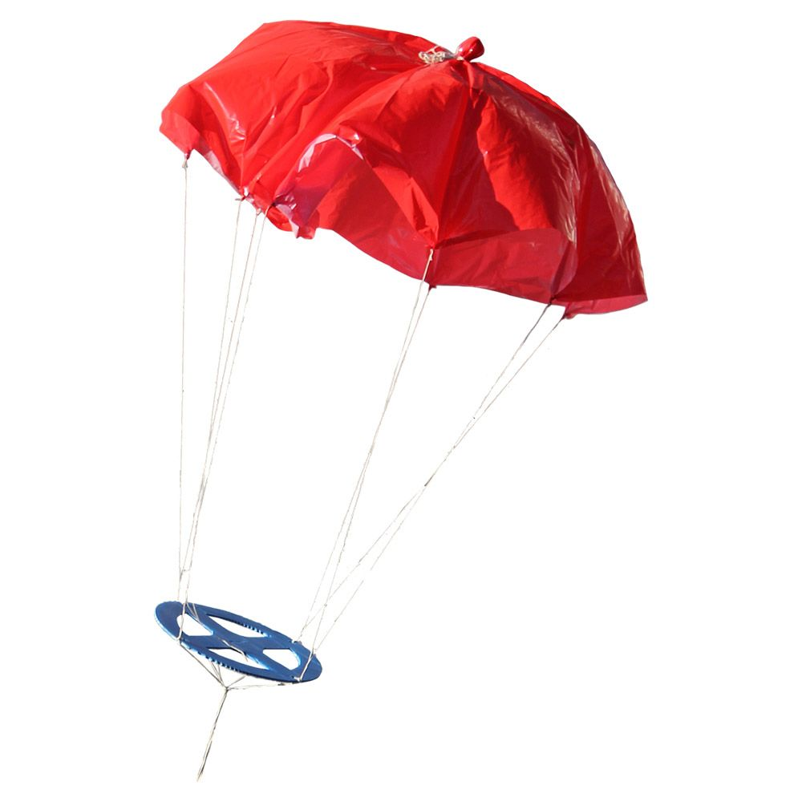
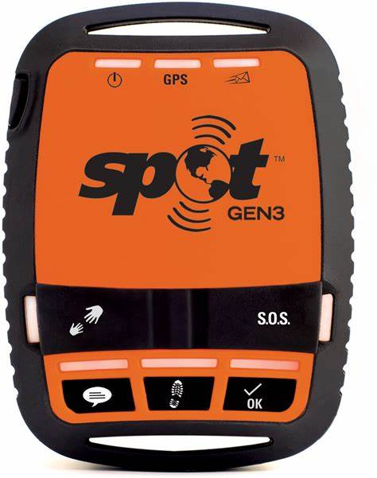
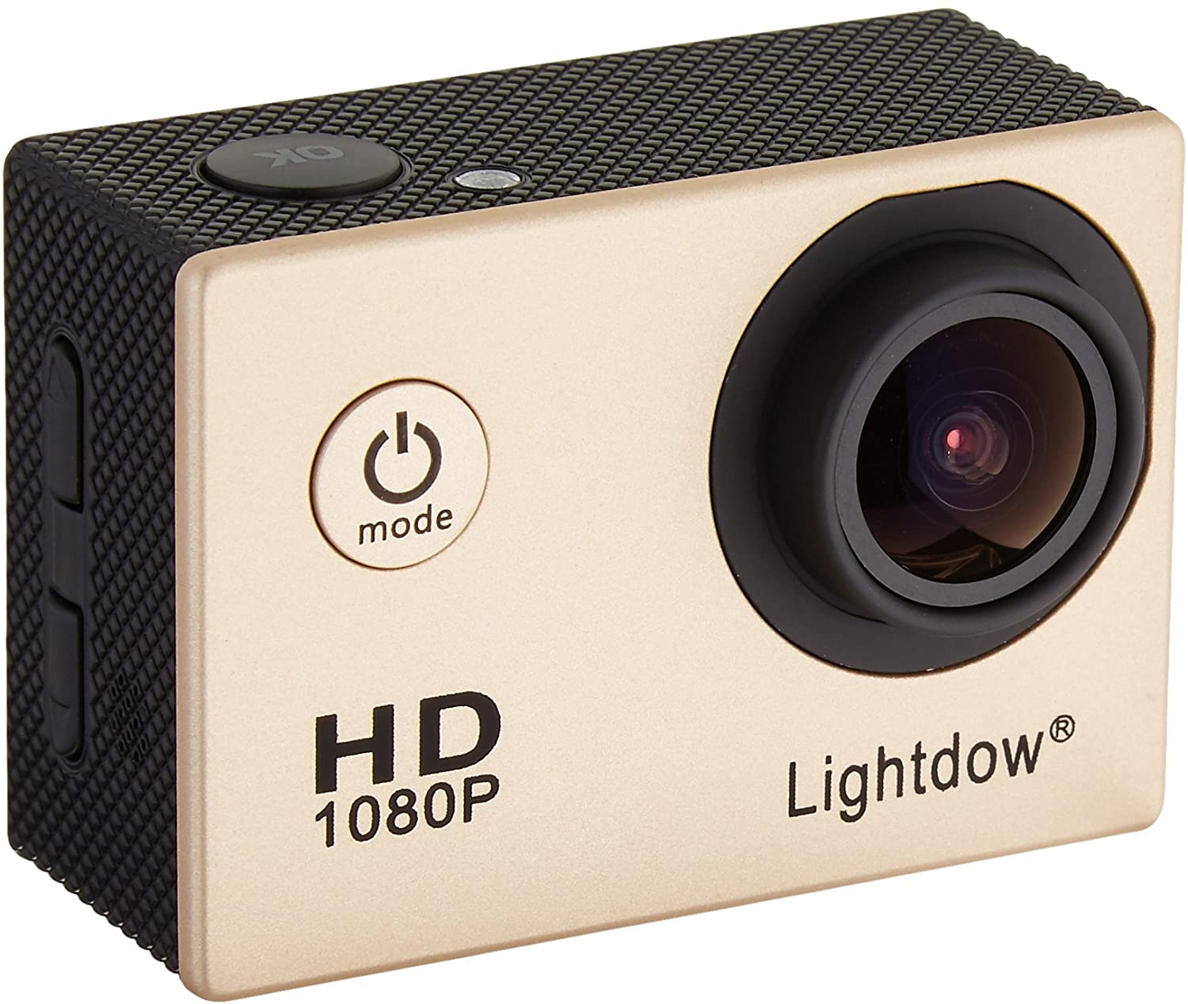
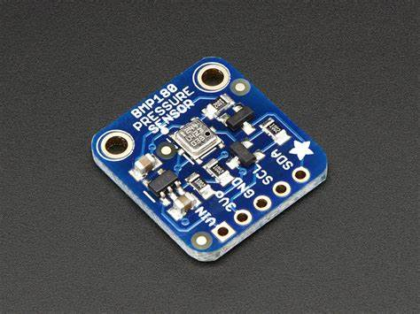
PAYLOADS
The payloads include scientific experiments on organisms, equipment to study radiation, temperature, ultraviolet radiation, and pressure. The balloon flights and experiments are logged by means of video devices and are tracked from the ground through multiple tracking devices.The following materials are going to be a default configurations:
GPS(Global positioning system)
Camera
Working or research materials
Parachute

Slide 5
LIGHTDOW 4000D
BALLISTIC PARACHUTES
MADE OF CARBON FIBRE TO ENSURE FAA GUIDELINES WEIGHT AND SAFETY OF THE PAYLOADS
CAMERA
GPS
PARACHUTE
PARACODE
PAYLOAD BOX
SPOT GEN 3
NEARLY 50ft

Slide 6
CHALLENGES FACED
CHALLENGES TO BE FACED:
Though it as easy and cheapest way, it has some challenges as follows:
ü surviving the mechanical rigors of the flight such as potential jet stream turbulence on ascent, fall-induced turbulence during the descent, and a parachute landing.
ü operating successfully in the harsh conditions of near space including low pressure, low temperature, and high cosmic radiation levels.
ü Tracking the flight using GPS-enabled system.
ü recovering the payloads safely from all sorts of terrain, including trees, tall crops, and open water includes power lines.
HAB

Slide 7
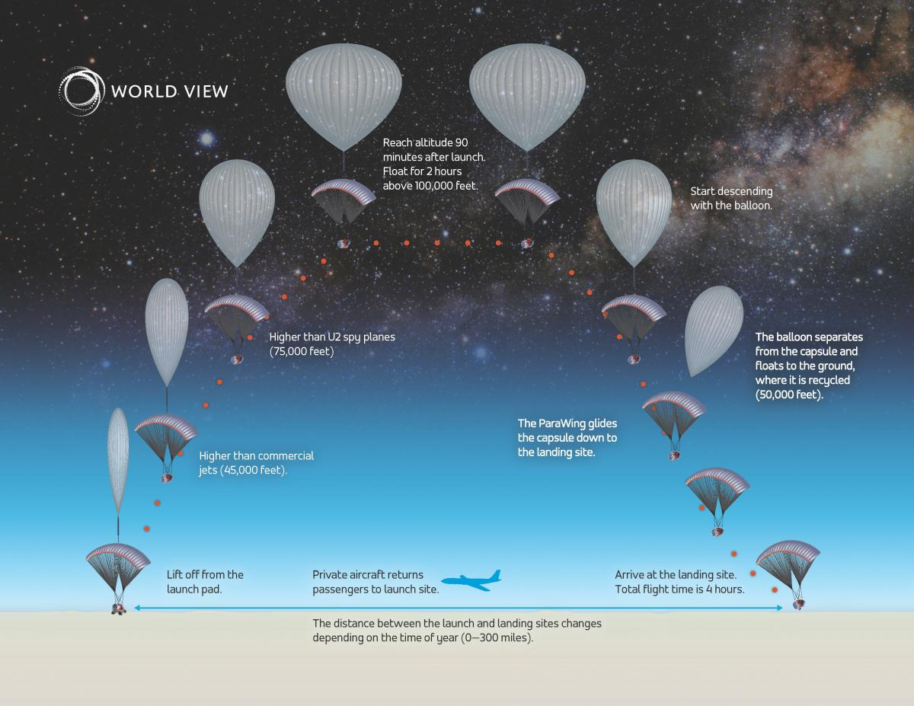
TRAVELLING LOCATIONS AND TEMPERATURES
TRAVELLING LOCATIONS AND TEMPERATURES:
The balloons ascend through the Tropopause then into the Stratosphere. The Tropopause is the area between the Troposphere and the Stratosphere. The Troposphere starts about 6km and continues until about 12km, with temperatures ranging from 62°F to -60°F. The Tropopause is the boundary separating the lower layer of the atmosphere (troposphere). The altitude of the tropopause varies according to sea-surface temperature and season, but also over shorter periods, from an average of 10–12 km over the North and South poles to 17 km over the equator.

Slide 8
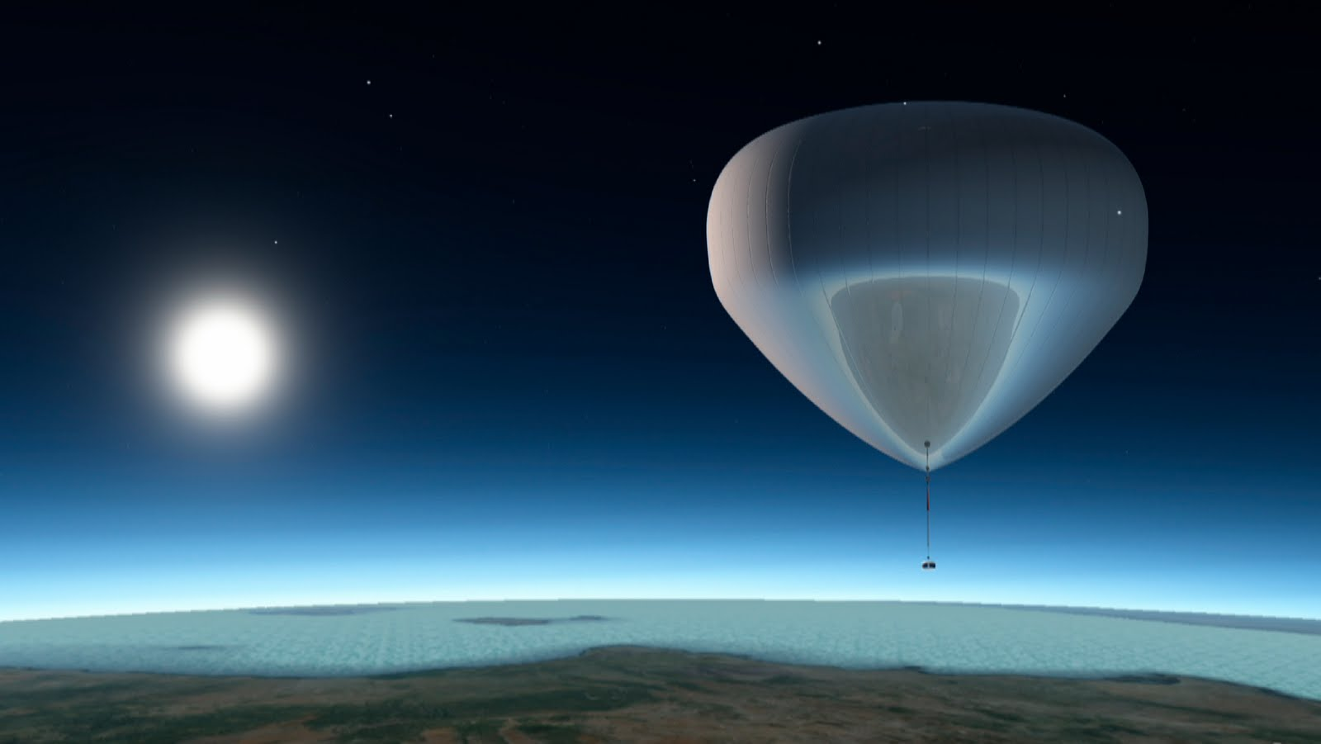
MATERIALS USED
MATERIALS:
scientific balloons are constructed of polyethylene film; the same type material used for plastic bags. This material is only 0.002 centimetres (0.0008 inches) thick, about the same as an ordinary sandwich wrap. The film is cut into banana-peel shaped sections called gores and heat sealed together to form the balloon. These standard, zero-pressure, balloons are open to the atmosphere at the bottom to equalize the internal pressure with the surroundings. The balloon system includes the balloon, the parachute and a payload that holds instruments to conduct scientific measurements.

Slide 9
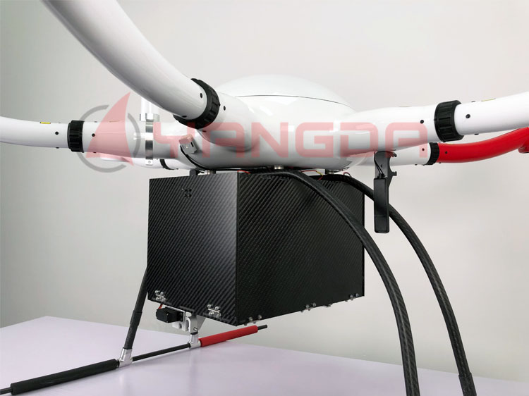
SEPARATION OF PAYLOADS:
SEPARATION OF PAYLOADS:
After the science measurements are complete, flight controllers send a radio command that separates the payload from the balloon. The payload floats back to the ground on a parachute where it can be retrieved and flown again. Payload separation creates a large tear in the balloon material, which releases any remaining helium. The balloon also falls to the ground, where it’s retrieved and discarded. The balloon and payload land approximately 45 minutes after separation.
We introduced a new method of using drone for a safe landing of our payloads more safely and in desired locations,which could reduce our time factor.As soon as it comes we can make an immediate launch of another HAB in instant an instant time.
PAYLOADS IN BOX MADE OF CARBON FIBRE

Slide 10
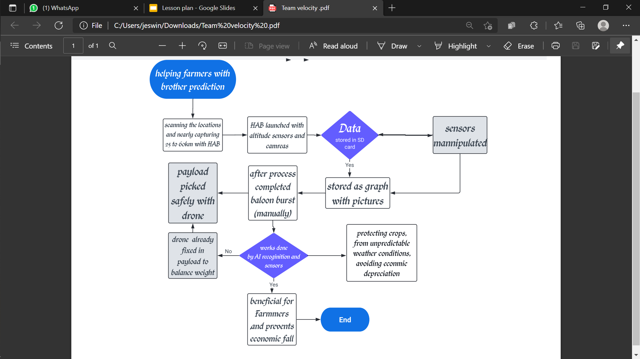
GEOGRAPHICAL MAPPING : WEATHER , CLIMATE DETECTION(AI BASED)
weather

Slide 11
HELIUM BALLOON
PARACHUTE
PARACODE
DRONE
PAYLOADS:
CAMERA
GPS
SENSORS
OUTLOOK

